Slide 1
CPS 109 - Lab 4

Slide 2
“Bin” there done that (A quick review of Binary Search)
Before we set you off to work on your lab, we’ll give you a quick review of Binary Search.
Different kinds of searches and sorts are very important in computer science, as is the analysis of their runtimes

Slide 3
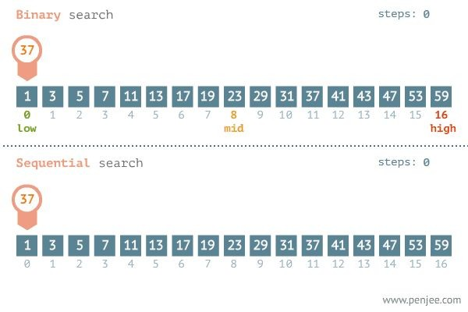
High Level Steps
Set mid to middle of a sorted array
If the number at the middle is greater than the number
we’re looking for then restrict our search to the lower half
If the number at the middle is less than the number we’re looking for then restrict
our search to the upper half
If the number at the middle is the number we’re looking for then return its index (done)
1. Continue 1. until we encounter c. or we have no range left (in which case, the number is not in the list).
To note: By halving our search space at each step, we are much more efficient than in a “naive” sequential search (but this requires a sorted array as input!)

Slide 4
Pseudocode Implementation
#Input: The list to search, the element to look for
#Output: The index of the element in the list, OR -1 if it is not in the list def binary_pseudocode(input_list, element_to_look_for):
low = 0, mid = 0, high = len(input_list)-1
while an unsearched range still exists: # What does this mean?
mid = the floor average of low and high # Recall | syntax: //2
if the item at mid == the element to look for:
return the index of the item at mid
if the item at mid > the element to look for:
update the range to be the lower half of the | list (update | high)
if the item at mid < the element to look for:
update the range to be the upper half of the | list (update | low)
return -1 # I.e. the element is not in the list
# Super cool hint: What are low and high equal to at | the end? Are | they
useful?

Slide 5
Binary Numbers
Author’s Note: No one works with binary numbers in Python.
Binary numbers are representations of real numbers in base 2.
Side note: “Decimal” now refers to numbers in base 10.

Slide 6
Binary Numbers
You know those fancy numbers when they show computers on TV? 10101010… Those are binary numbers.
Converting between decimal and binary is pretty easy!

Slide 7
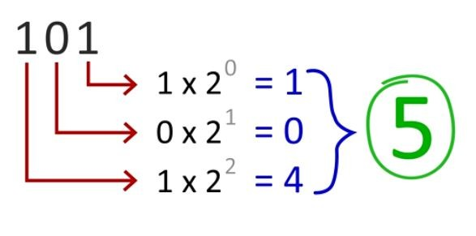
Binary Numbers

Slide 8
Binary Numbers
That last slide shows us how the 1s and 0s correspond with powers of 2. So, here is, essentially, how to count:
1 = 1
10 | = | 2
11 | = | 3
100 | = | 4
101 | = | 5
110 | = | 6

Slide 9
Binary Numbers Practice
Why don’t we try some examples together?
Decimal: 69 Binary: 1000101
Binary: 101
Decimal: 5
Binary: 111001
What’s the largest exponent of 2
that goes into 69?:
2**6
= 64 (Total: 64, Rem: 5)
What’s the next largest that goes
Decimal: 57
2**0 + 2**3 + 2**4 + 2**5
=
1 + 8 + 16 + 32 = 57
into 5?: 2**2
= 4 (Total: 64 + 4 = 68, Rem: 1)
What’s the next largest that goes
into 1?:
2**0
= 1 (Total: 68 + 1) = 69

Slide 10
